Slide 1
Nipah Virus Protein Evolutionary Selection Analysis
Sanjana Kulkarni
EcoHealthNet 2022

Slide 2
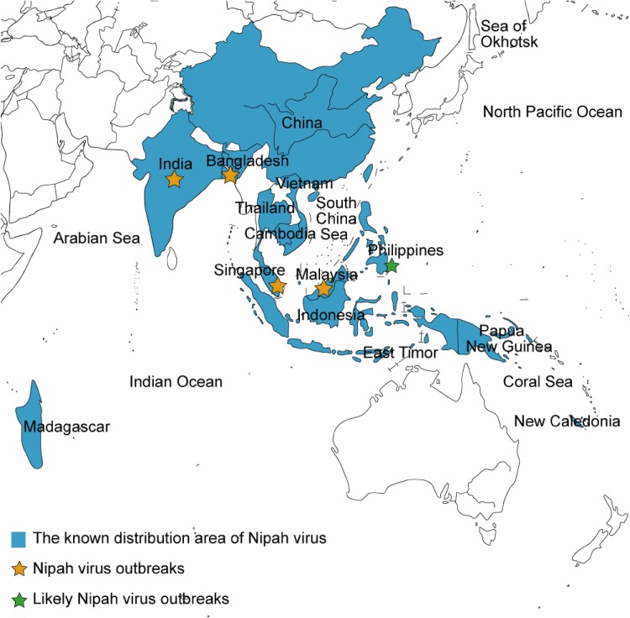
Background on Nipah Virus (NiV)
Malaysia (M) Clade | Bangladesh (B) Clade
Fatality rate ~40% | Fatality rate ~70%
Mostly animal-to-human transmission | Human-to-human transmission
Some asymptomatic cases | Almost no asymptomatic cases
Sun et al., 2018. Phylogeography, Transmission, and Viral Proteins of Nipah Virus. Virology Sinica

Slide 3
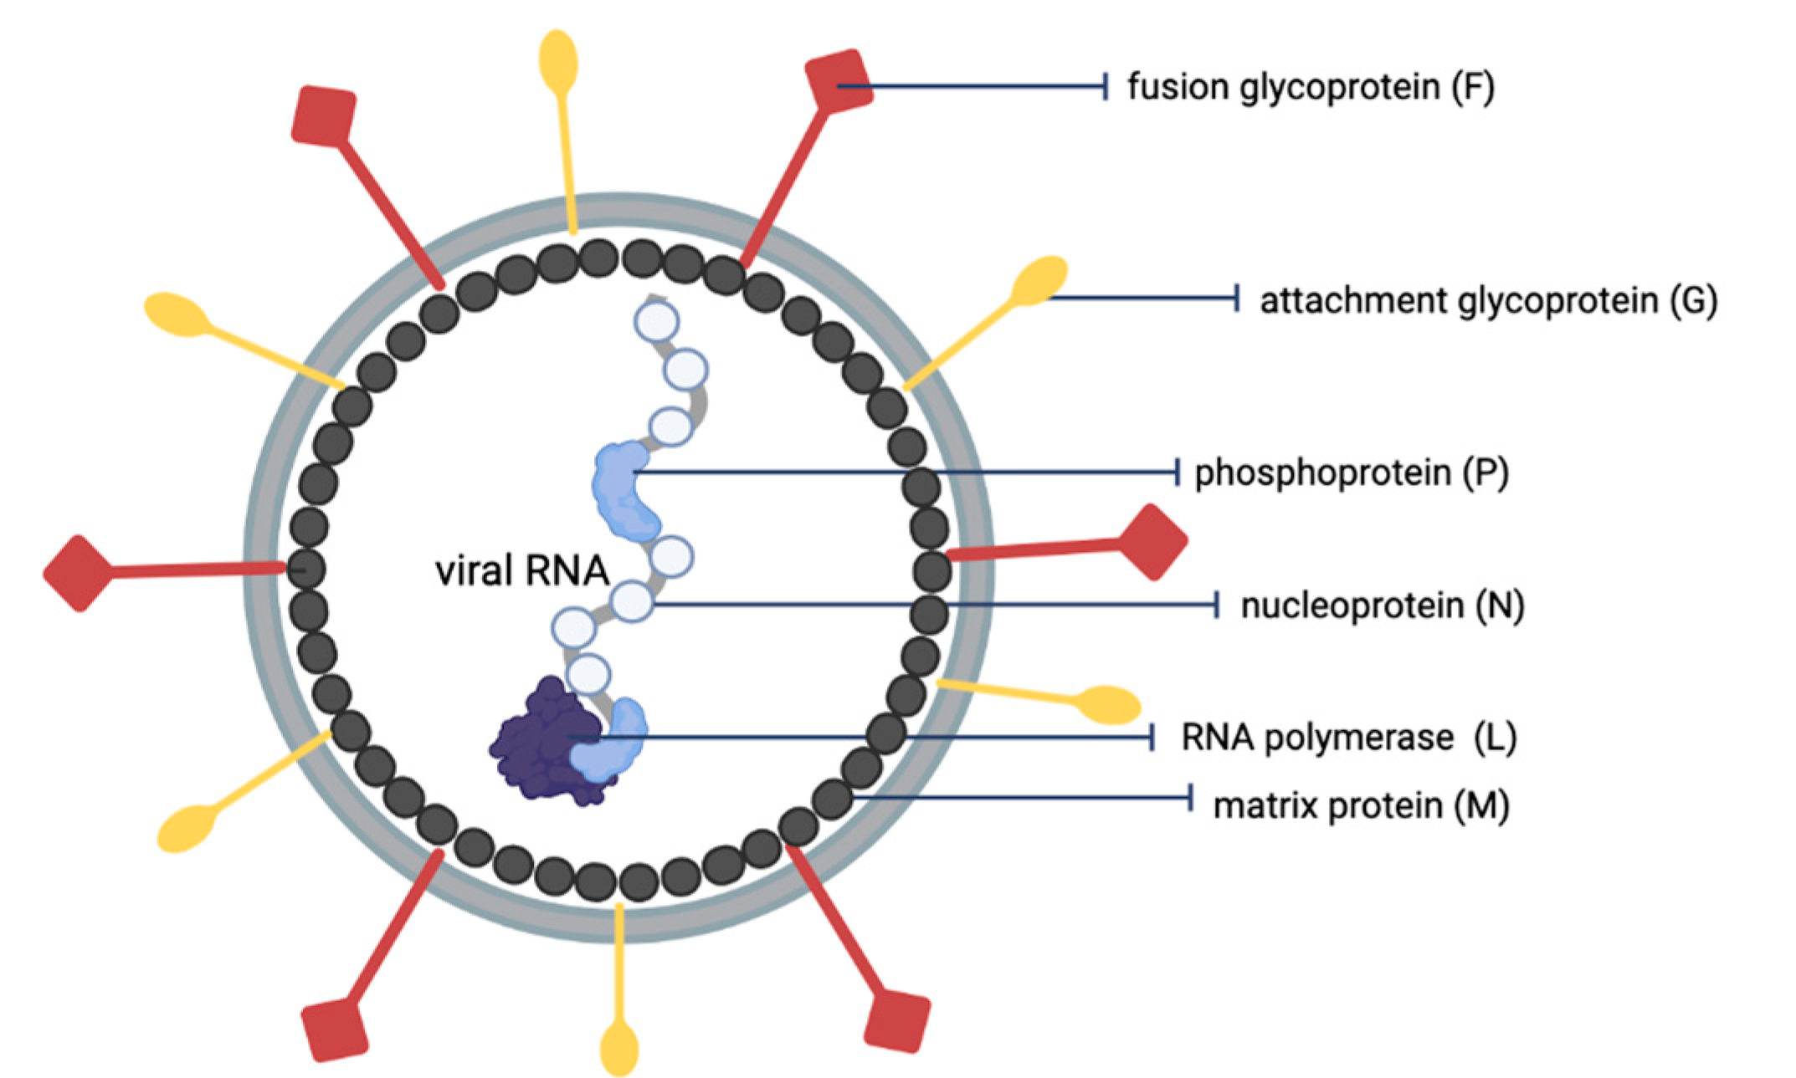
Background on Nipah Virus (NiV)
→ attachment to host cells
→ immune invasion, assisting replication
What molecular differences can account for differences in clinical severity between clades?
Liew et al., 2022. The Immunobiology of Nipah Virus. MDPI

Slide 4
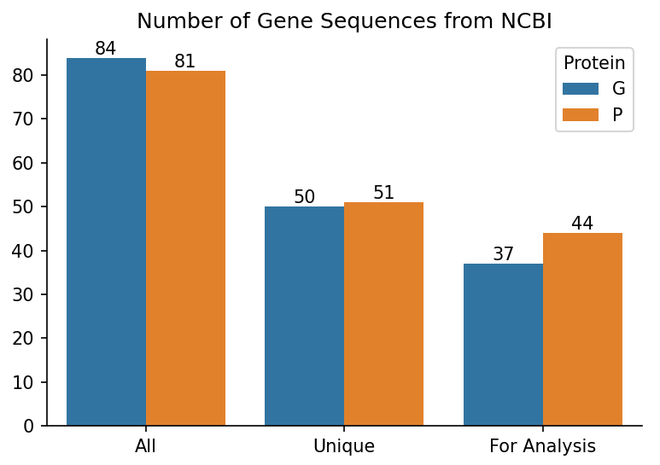
Data Collection
Collected all publicly available NiV protein sequences from NCBI.
Many identical sequences from different NiV isolates.
Removed sequences containing ANY ambiguous nucleotides because the dataset is not robust.

Slide 5
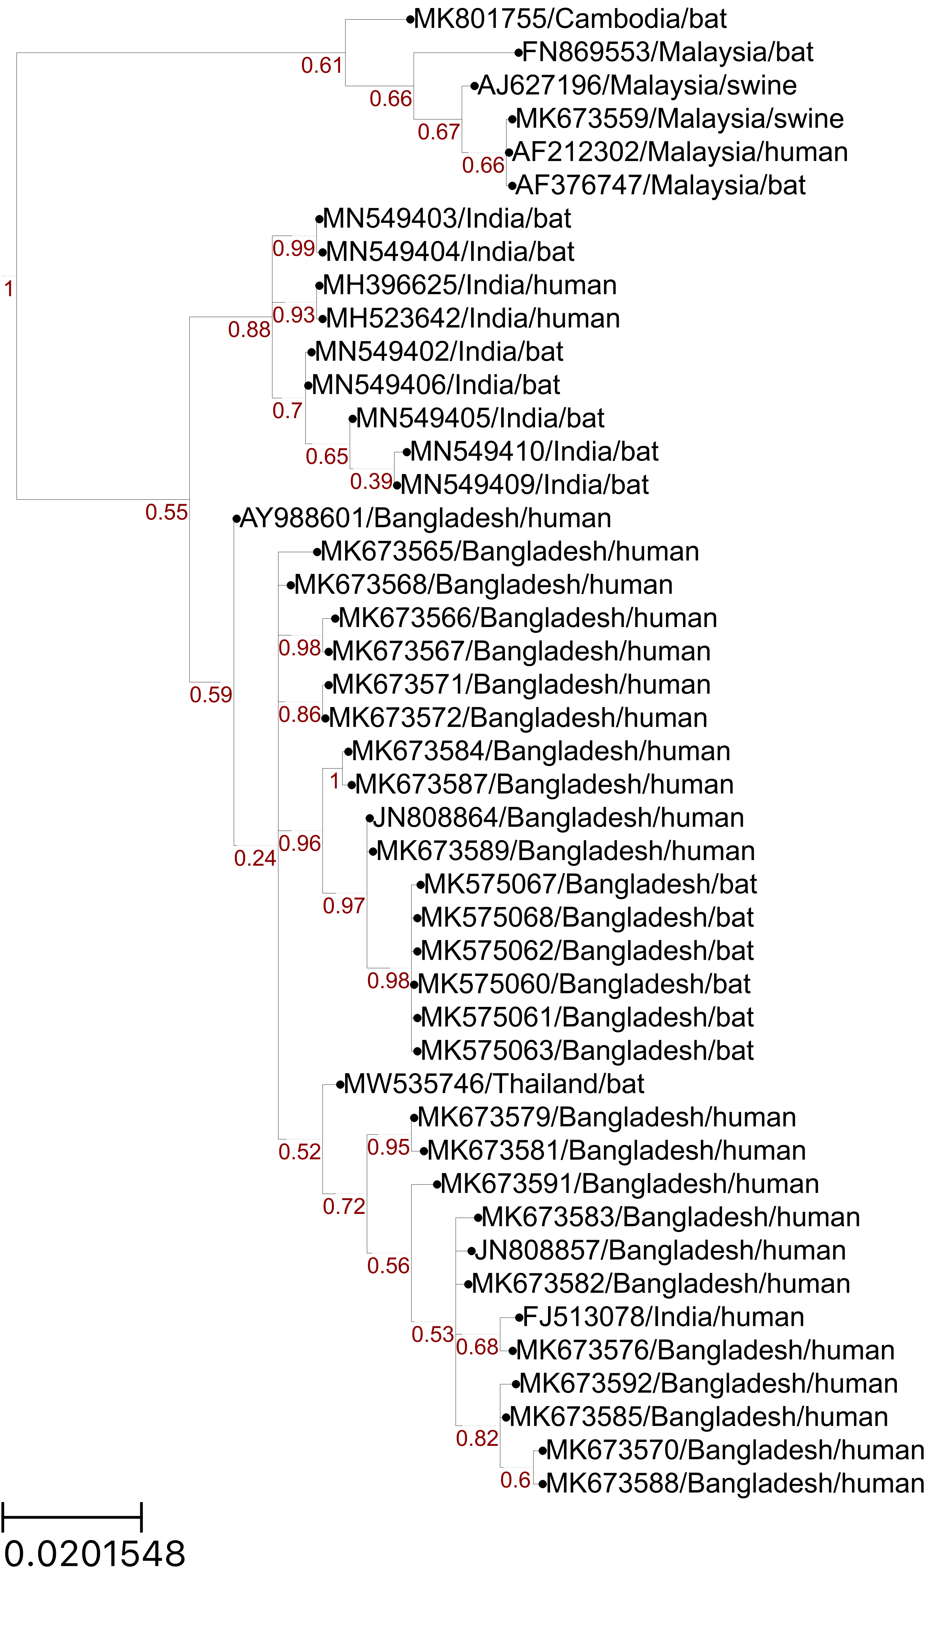
Building Phylogenetic Trees: Phosphoprotein
Malaysia
India
Bangladesh
Notes:
FEL also identified site 380
Not sure how to use the Empirical Bayes Factor to help with analyses. Provides a confidence measure of whether diversification occurred in a given branch? The paper seems to mention EBF values > 1, but the table outputs proportions between 0 and 1.

Slide 6
Evolutionary Selection Algorithms

Slide 7
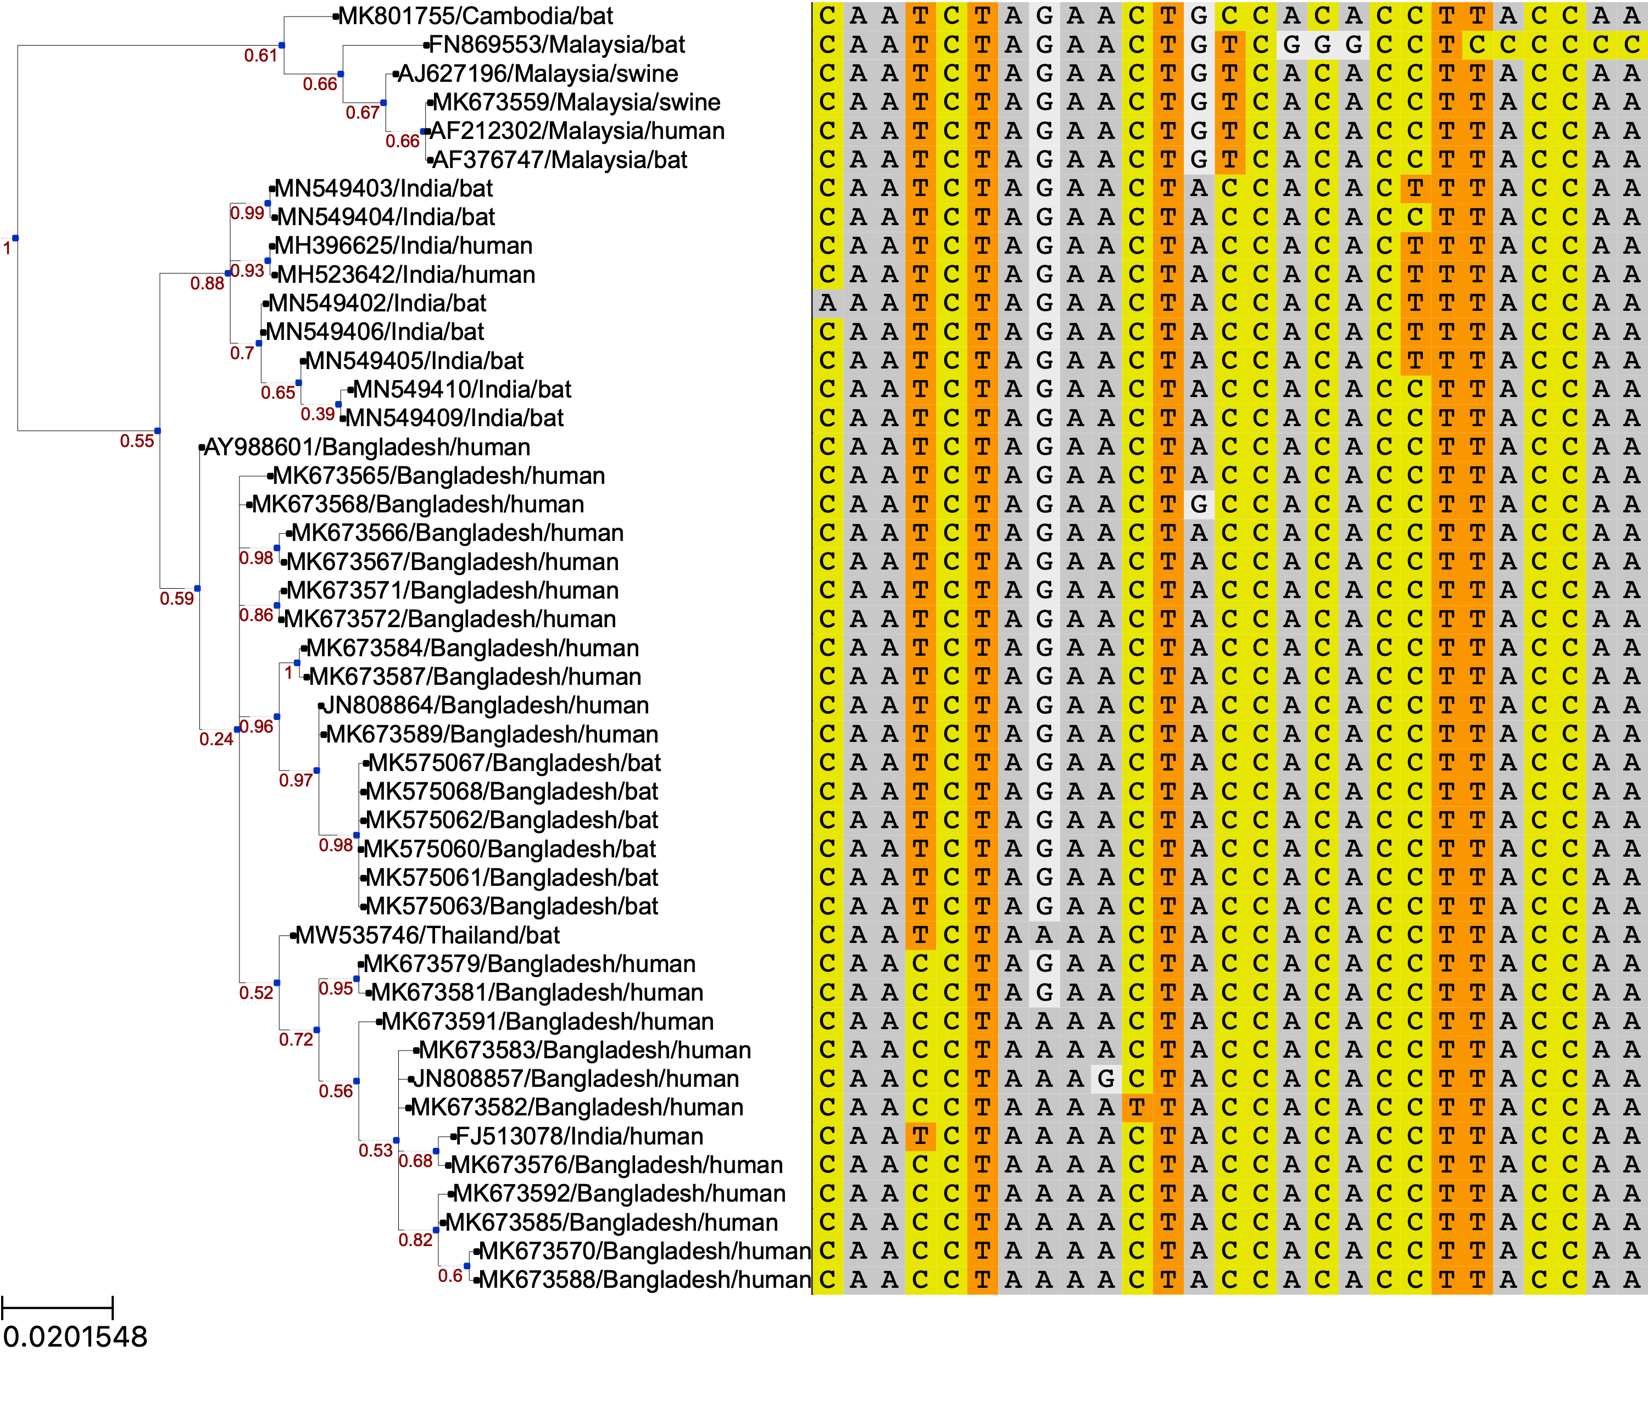
Codons under Positive Selection
58 64 228 377 380 408 421 437 438
Malaysia
India
Bangladesh
Notes:
FEL also identified site 380
Not sure how to use the Empirical Bayes Factor to help with analyses. Provides a confidence measure of whether diversification occurred in a given branch? The paper seems to mention EBF values > 1, but the table outputs proportions between 0 and 1.

Slide 8
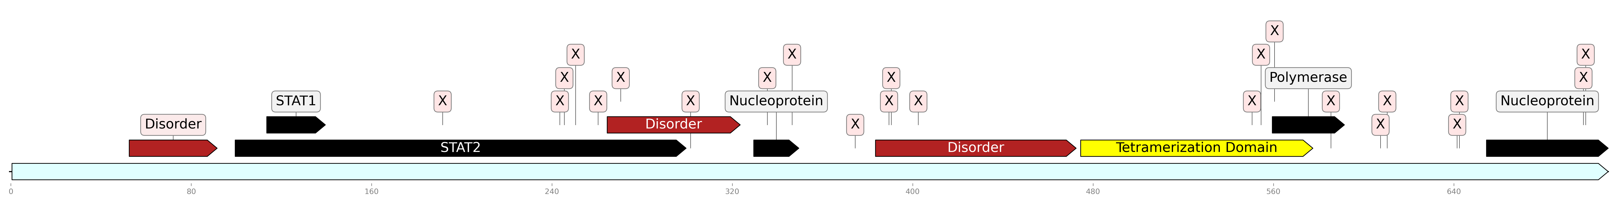
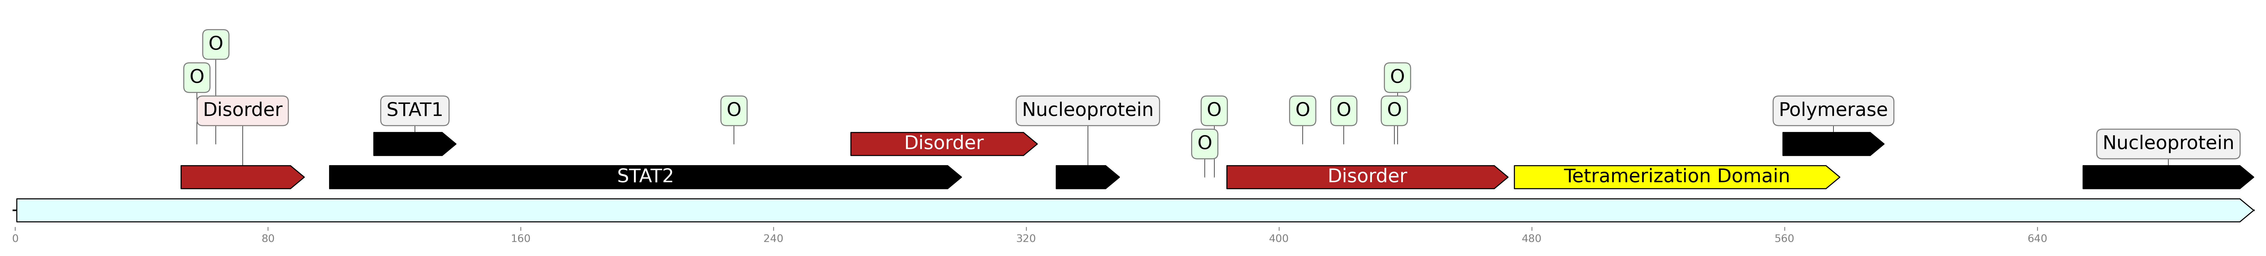
Sites under Positive or Negative Selection
22 Sites under negative selection, p ≤ 0.1
9 Sites under positive selection, p ≤ 0.1

Slide 9
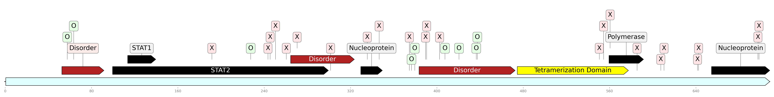
Sites under Positive or Negative Selection
No phosphoprotein structures available for the region AA 51-470
Disordered regions and polymerase and nucleoprotein sites also show evidence of significant differences in dN/dS rates between clades.
Notes:
Combined

Slide 10

aBSREL branch with diversifying selection
Malaysia
India
Bangladesh

Slide 11
Comparison between Proteins
Protein | Length (AA) | Number of Sites under Positive Selection | Number of Sites under Negative Selection
Phosphoprotein | 709 | 9 (1.3%) | 57 (8%)
Glycoprotein | 602 | 3 (0.5%) | 62 (10.3%)
Polymerase | 2244 | 11 (0.5%) | 232 (10.3%)
Notes:
Include negative selection sites. Get dN and dS from Whitmer et al and add to table

Slide 12
Conclusion
Some evidence of positive selection in phosphoprotein: 1.3% of sites, compared to 0.5% in glycoprotein and polymerase protein.
Positive selection in phosphoprotein tends to occur in disordered or protein-binding regions. Could perform in vitro experiments to make amino acid variants in the genetic backgrounds of each clade’s phosphoprotein and observe properties.
Dataset is too limited to make reliable conclusions. → Bat sampling by EcoHealth is ongoing in Bangladesh!

Slide 13


Acknowledgements
Dr. Maria (Maryska) Kaczmarek
Dr. Cadhla Firth
Dr. Jonathan Epstein
Sarah Munro
Dr. Maha Farhat
Dr. Anna Green
Max Marin
Nikki Commins

Slide 14
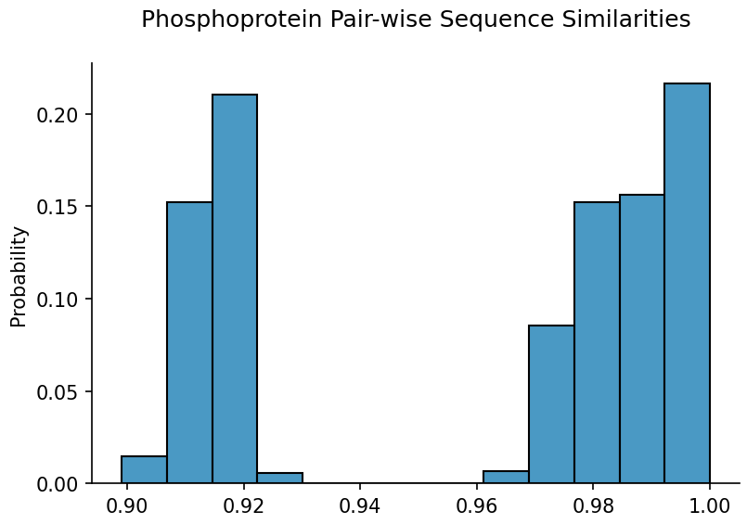
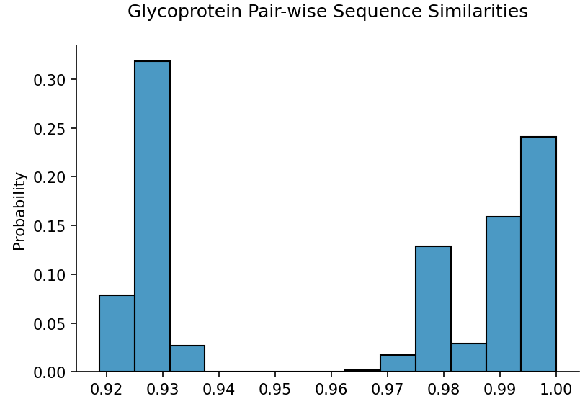
Study Limitations
Dataset is far too small too limited to make reliable conclusions!
Between clades
Within clades
Between clades
Within clades

Slide 15
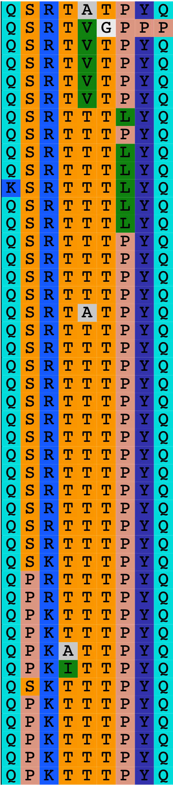
Amino Acids under Positive Selection
Malaysia
India
Bangladesh
Notes:
FEL also identified site 380
Not sure how to use the Empirical Bayes Factor to help with analyses. Provides a confidence measure of whether diversification occurred in a given branch? The paper seems to mention EBF values > 1, but the table outputs proportions between 0 and 1.

Slide 16



Sites with different dN/dS Rates: Bangladesh vs. Malaysia
Also positive selection
1 additional site when separating Indian isolates
Notes:
Positions 408, 437, 438 overlap between Contrast FEL and positive selection. All in the 3rd disordered region.

Slide 17
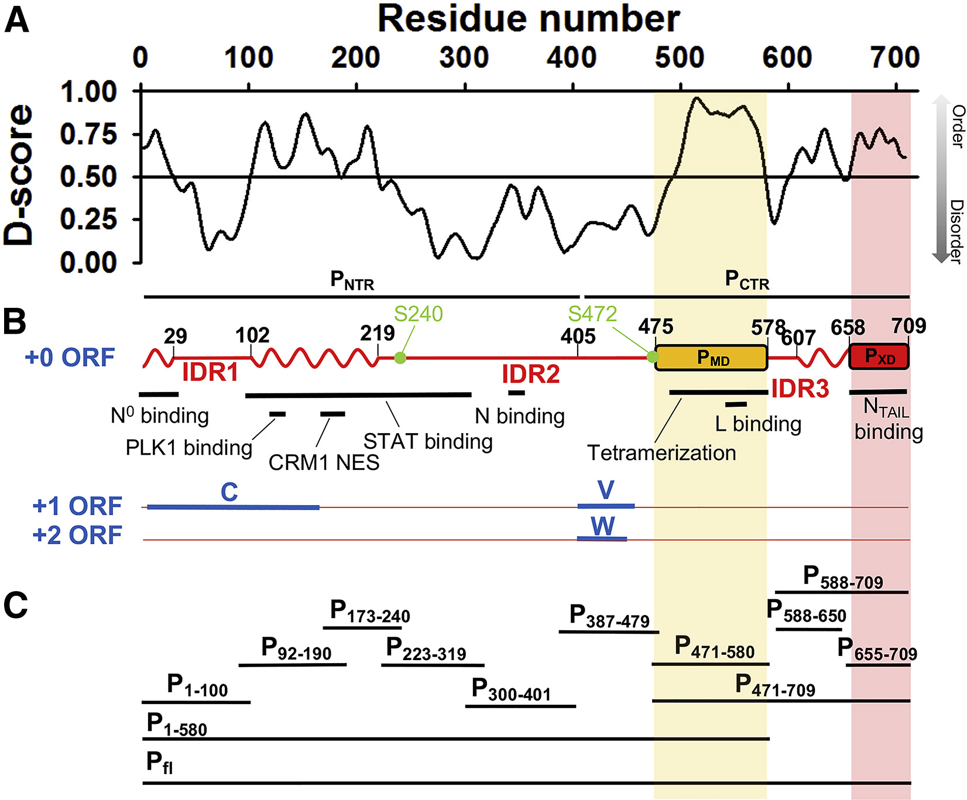
Jensen et al., Biophysical Journal, 2020
Notes:
Intrinsically disordered proteins may allow more mutations (diversifying selection) because structure isn't very constrained. BUT intrinsically disordered viral proteins also tend to bind a lot of other proteins. It's like both things at once -- constrained for binding, but unconstrained structurally.
Look at short proteins in evolutionary selection. If you have small proteins and small datasets, can you find anything? Look at some papers.

